Slide 1


User Needs
Strategy (Part 2)

Slide 2
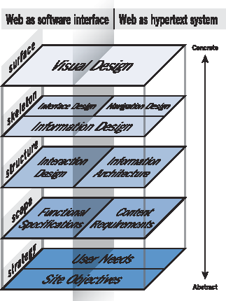
Source: Garrett, 2002

Slide 3
‘User needs’ are the needs that a user has of a service, and which that service must satisfy for the user to get the right outcome for them.
Services designed around users and their needs:
Are more likely to be used.
Help more people get the right outcome for them - and so achieve their policy intent.
Often cost less to operate by reducing time and money spent on resolving problems.
User Needs
Notes:
Customer experience can overtake price in terms of product differentiation

Slide 4
The Strategy Layer
Site objective ➔ the inside out thinking
User needs ➔ the outside in thinking

Slide 5
User/Customer Segmentation
User Needs
Break the audience down into chunks. Use:
Personas (aka Personae, Personi)
Customer Scenarios/Customer Journeys

Slide 6
Personas
Personas are fictional characters that represent typical website users, summarizing their characteristics, needs, motivations, and environments.
They often include details like age, gender, occupation, education, and location, as well as insights into lifestyle and experiences that affect how they interact with a product.
Personas clarify the goals users want to achieve on a website, the challenges they face that the site can help solve, and their typical behaviours with technology, such as preferred devices and browsing habits.

Slide 7
Personas
Personas are essentially a ‘thumbnail’ description of a type of person. They have been used for a long time in research for segmentation and advertising, but since the mid 1990s have proved effective for improving web site design.

Slide 8
Personas
Persona 1 – George: George is a 65 year old violin teacher who doesn’t use the Internet much. He accesses the Internet from home but lives in a rural area and so the service is slow. He has never purchased online before, preferring to place orders by phone.
Persona 2 – Georgina: Georgina is a 29 year old ad exec who has been using the Internet for many years. She uses many online services and is an avid social media user.
You can see that these are quite different types of people who will have quite different needs.

Slide 9
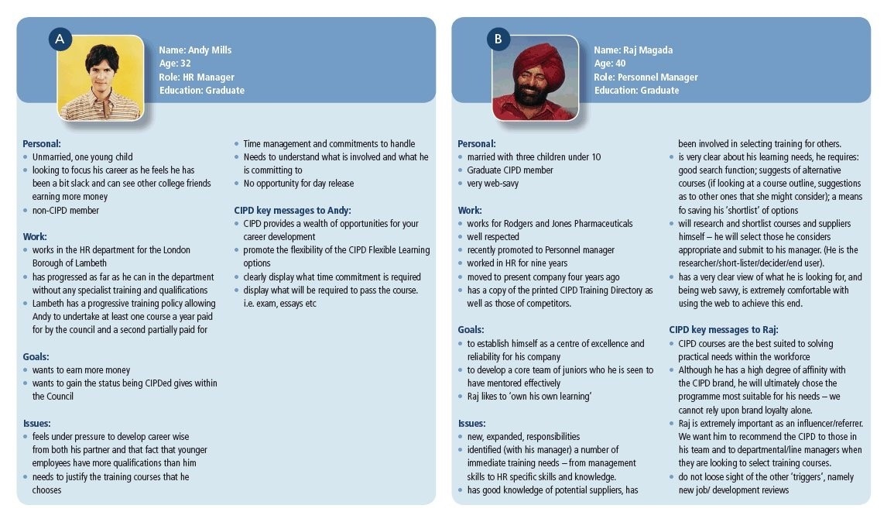
Personas
https://www.smartinsights.com/persuasion-marketing/marketing-personas/
Notes:
CIPD: Chartered Institute of Personnel and Development

Slide 10



Start or end with giving your persona a name. The detailed stages are:
Build personal attributes into personas:
Demographic: Age, gender, education, occupation and for B2B (business to business), company size, position in buying unit.
Psychographic: Goals, tasks, motivation
Webographics: Web experience (months), usage location (home or work), usage platform (rural broadband, fast broadband), usage frequency, favourite sites
Developing Personas
Remember that personas are only models of characteristics and environment:
3 or 4 are usually sufficient to improve general usability, but more needed for specific behaviours
Choose one primary persona whom, if satisfied means others are likely to be satisfied

Slide 11
Use personas to feed into the rest of the design process. Specifically, to do the following:
Understanding the user: Knowing who our users are and what they understand about the task is essential for designing a product that is user-friendly. This approach also helps new team members, including consultants, quickly learn about the product, the business context, and the users’ needs.
Clarifying assumptions: People don't always verbalise their assumptions. Written scenarios help team members share and formalize assumptions so there are fewer surprises later.
Fully exploring the design: Scenarios provide a vehicle for exploring all of the important aspects of the interface.
Providing a context for reviewers: Detailed scenarios provide a context for understanding the features of interface specs, functional specs and other project documents.
Helping other project tasks: Scenarios represent the important tasks that major classes of users are expected to perform. They are useful in usability testing, documentation, QA and other areas.
Using Personas

Slide 12
Customer Scenario (Journey)
Customer scenario is a narrative that describes how a specific persona interacts with a website to achieve a particular goal.
Scenarios provide context around user behaviour, outlining the steps, motivations, and challenges faced by users while navigating through a digital experience.
They help developers, designers, and stakeholders understand users' interactions in a more concrete way.

Slide 13
Customer scenarios (customer journeys) are developed for different personas.
Customer Scenarios & Customer Journeys
A customer scenario is a set of tasks that a particular customer wants or needs to do in order to accomplish his or her desired outcome.

Slide 14

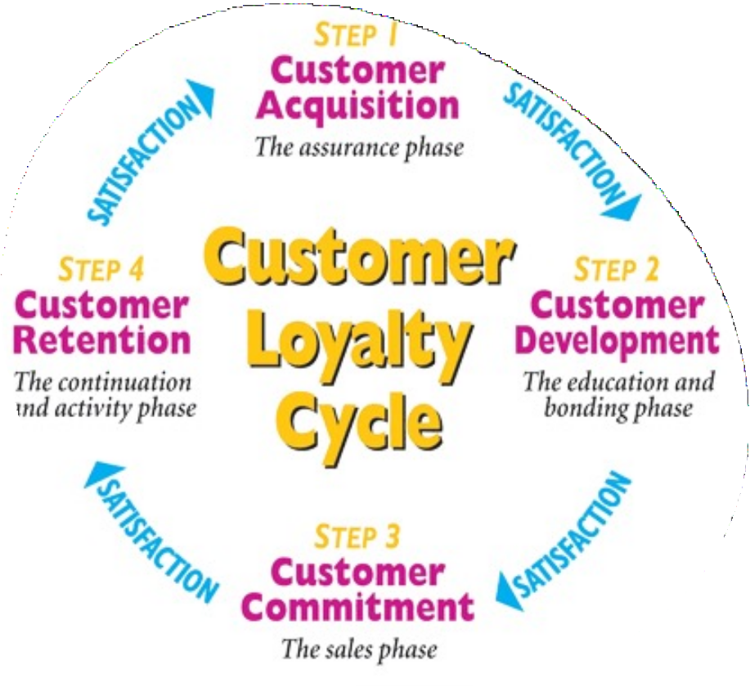
Customer Lifecycle
Source: Customer Loyalty - Definition & Process | Marketing Overview | MBA Skool

Slide 15
Acquisition - step focuses on acquiring a new customer by offering a product or service which satisfies the customer needs. If the customer is satisfied, he or she can be nurtured to good customer loyalty. Development - is where in the customer is educated about all the benefits of being a customer. This is more of a bonding phase between the company, the product and the customer. Commitment - is a process where the company is committed to offering the benefits and value that the customer seeks. This helps build a strong trust with the company and its product. Retention - is one of the most important steps especially in a competitive market. Customer loyalty is largely driven by incentives and perks given to customers who are willing to stay loyal towards a particular company.
Customer
Loyalty
Cycle
Source: Customer Loyalty - Definition & Process | Marketing Overview | MBA Skool

Slide 16
Different Customer scenarios can be developed for each persona:
Developing Scenarios using Personas
Information seeking scenario (leads to site registration); CAcquisition to CDevelopment;
Purchase scenario – new customer (leads to sale); CDevelopment to CCommitment;
Purchase scenario – existing customer (leads to sale); CCommitment to CRetention.

Slide 17
Scenarios should be developed for each persona.
Customer Scenarios & Customer Journeys
E.g. For an online bank, scenarios might include:
New customer – opening online account
Existing customer – transferring an account online
Existing customer – finding an additional product
Each scenario is split up into a series of steps or tasks before the scenario is completed. These steps can be best thought of as a series of questions a visitor asks. These questions identify the different information needs of different customer types at different stages in the process.

Slide 18
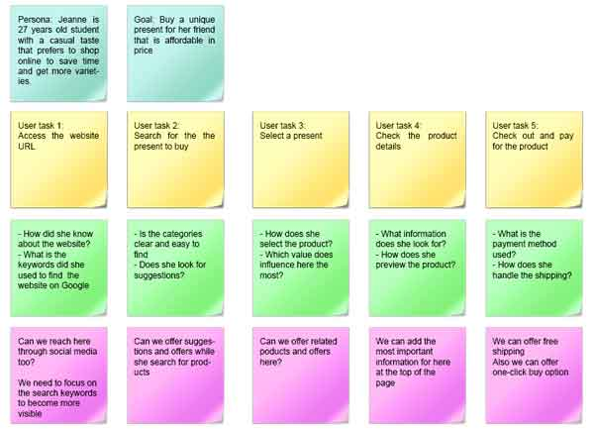
https://www.designorate.com/guide-ux-research-scenarios/

Slide 19
Examples: -
https://www.designorate.com/guide-ux-research-scenarios/
https://www.justinmind.com/blog/how-to-design-user-scenarios/
https://alistapart.com/article/audiences-outcomes-and-determining-user-needs/
Site Objectives and User Needs Documentation

Slide 20
Exercise (10-15 Minutes)
Related to the site you are thinking about for your assignment create 3 personas.
Then develop 3 customer scenarios for them.
If you don’t have an idea for your assignment yet, then instead consider a well-known website.

Slide 21
Site Objectives
Why will this site exist?
Why will people visit? And return? How will you measure the success of the website?
How will the site create revenue?
UX
Strategy - Summary
Use KPIs and CSFs
https://www.productiveflourishing.co m/the-difference-between-critical- success-factors-and-key-performance- indicators/

Slide 22
User Needs
Personas, Customer Journeys and Customer Scenarios
UX
Strategy - Summary
Requirements – functional and usability
Document and then use this as the basis upon which to develop the rest of the UX for the site

Slide 23
Referencing
Chapter 3 in The Elements of User Experience: User-Centered Design for the Web and Beyond book by Jesse James Garrett

